Slide 1

Module 3
Dimension Reduction
Notes:
Guidelines
Use section headers to chunk content in your presentation.
Use the same style of section header throughout your presentation.
Keep your title to no more than 2 lines.

Slide 2
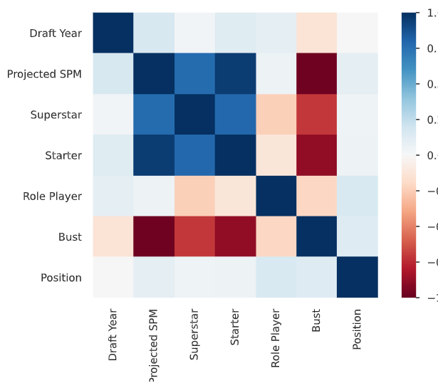
Reducing Dimensionality for Numeric Variables
Notes:
Guidelines
Use a title slide at the beginning of your presentation. There are 9 variations of title slides to choose from.
If you will have a series of slideshows, we recommend using the same style of title slide for each presentation.
Keep your title to no more than 2 lines.
Do not change the font style or font size of the title or subtitle.

Slide 3
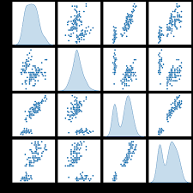
Reducing Redundancy in Numeric Vars
Continuous variables cost 1 model degree of freedom each.
We only consider reducing redundant continuous variables.

Slide 4
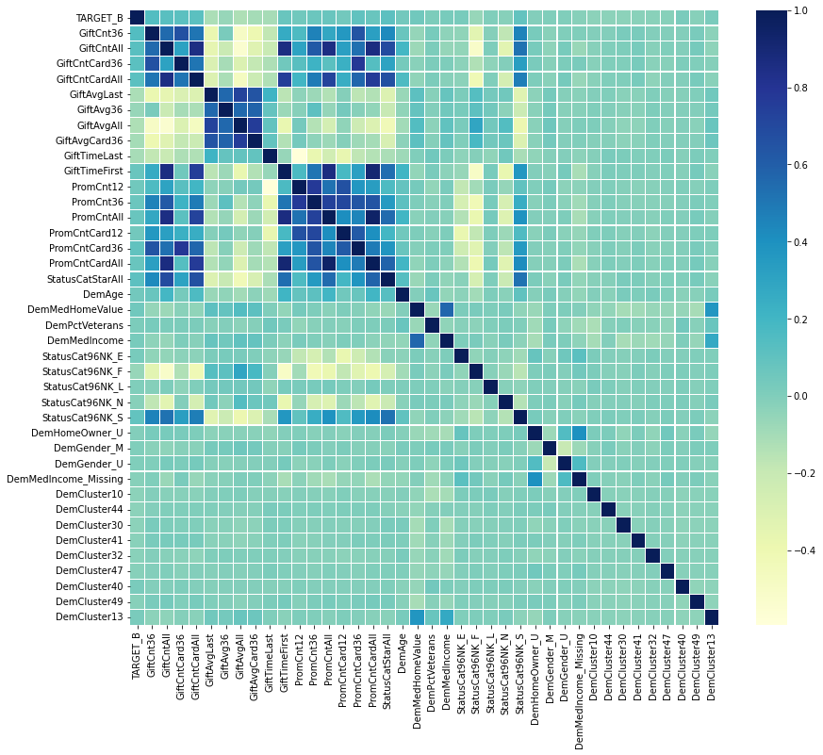
Reducing Redundancy in Numeric Vars

Slide 5
Python
Notes:
Guidelines
Use a title slide at the beginning of your presentation. There are 9 variations of title slides to choose from.
If you will have a series of slideshows, we recommend using the same style of title slide for each presentation.
Keep your title to no more than 2 lines.
Do not change the font style or font size of the title or subtitle.

Slide 6
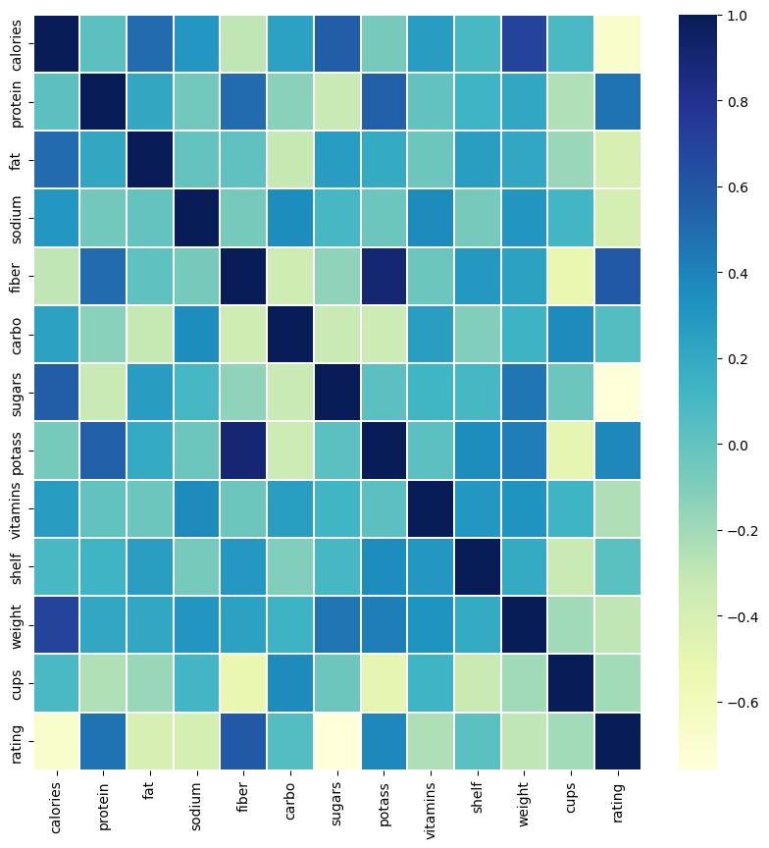
Reducing Redundancy in Numeric Vars

Slide 7
Reducing Redundancy in Numeric Vars

Slide 8
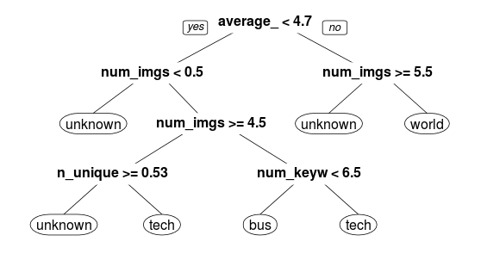
Selecting Variables (Var Importance)

Slide 9
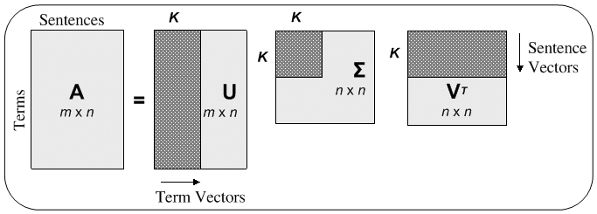
Singular Value Decomposition
Factorization of a given matrix into three different matrices.
Important applications in data science

Slide 10
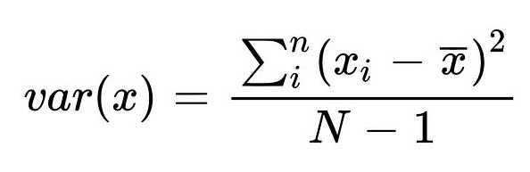
Variation as Information
Variance is an estimate of variability
More variability implies more information

Slide 11
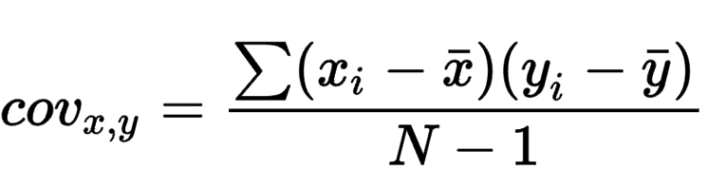
Covariance
Covariance is an estimate of joint variability of two variables
Higher covariance implies a higher relationship between vars

Slide 12
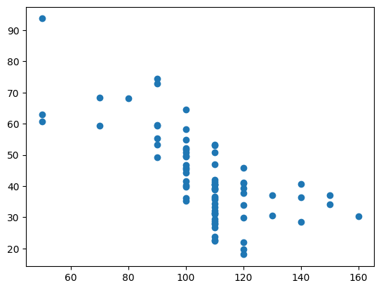
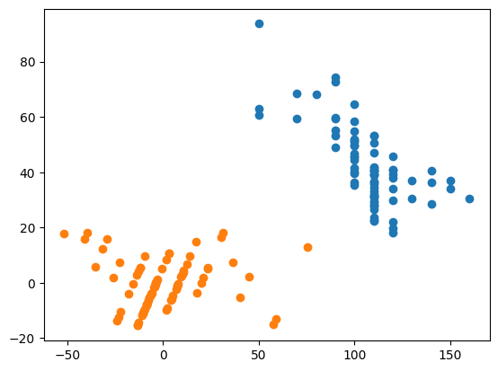
Identifying Information (Variation)

Slide 14
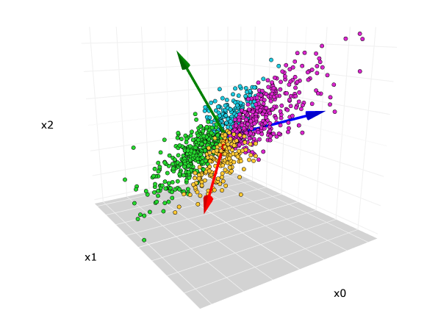
Principal Component Analysis
Used to remove redundancy (high collinearity) of predictors
Based on covariance and variance

Slide 15
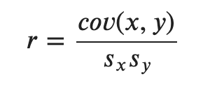
Principal Component Analysis
The correlation coefficient is related to the covariance

Slide 16
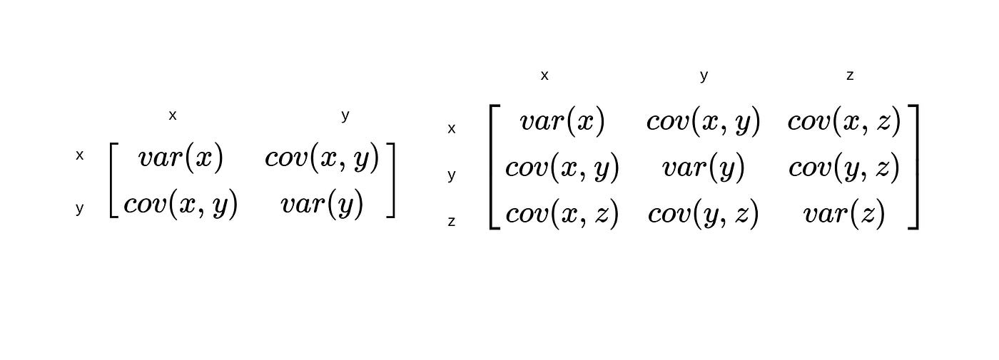
Principal Component Analysis
The covariance matrix allows us to see both variances and covariances

Slide 17
Principal Component Analysis
Create new variables (PCs) that keep high variance (information)
PCs are linear combinations of variables (keep info about all)
PCs must have covariances equal to zero

Slide 18
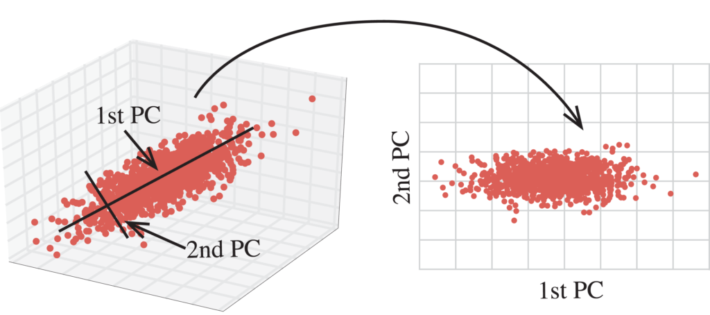
Principal Component Analysis
Create new variables (PCs) that keep high variance (information)

Slide 19
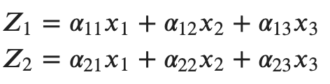
Principal Component Analysis
PCs are linear combinations of variables (keep info about all)

Slide 20
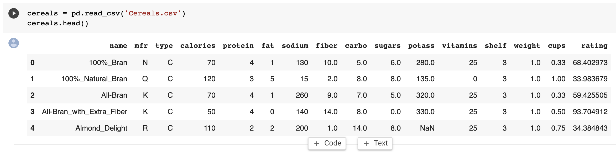
Principal Component Analysis
Cereals data example

Slide 21
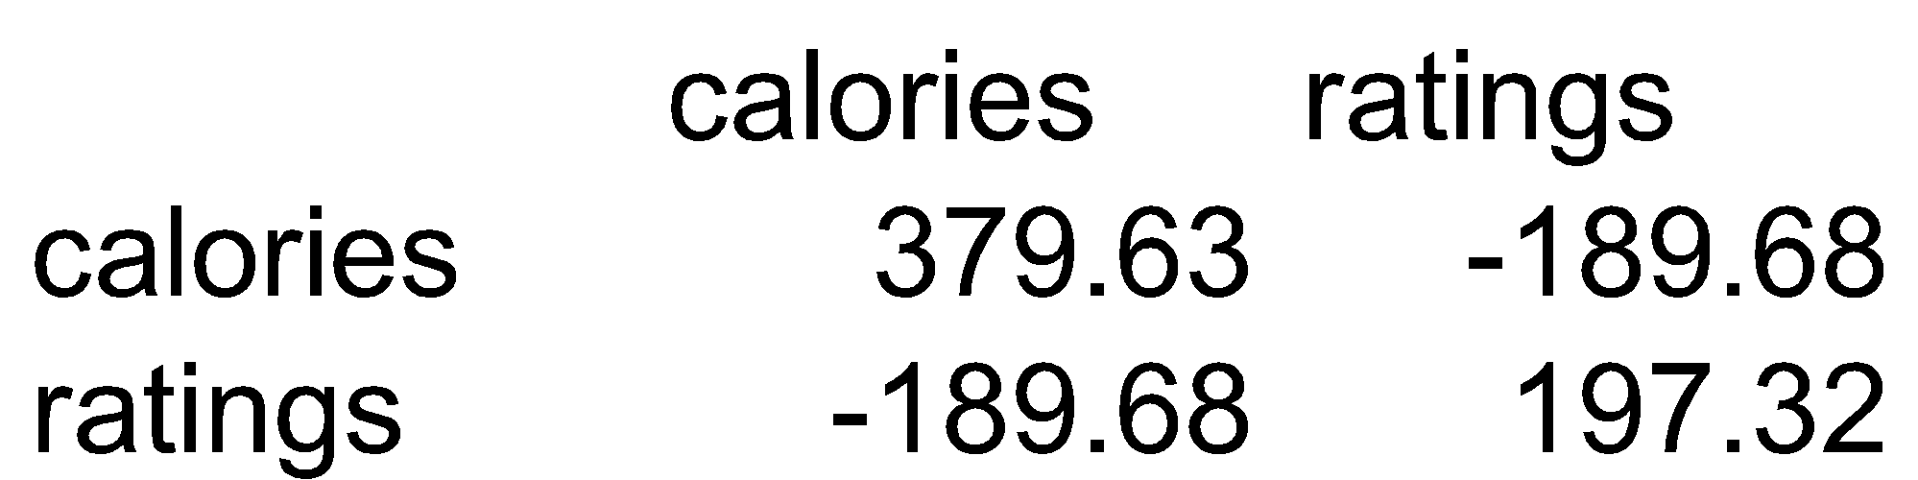
Principal Component Analysis
Cereals data example

Slide 22
Principal Component Analysis
Total variance (“information”) is sum of individual variances
Calories accounts for 379.63/577 = 66% of information
34% of the variation information is contributed by Ratings

Slide 23
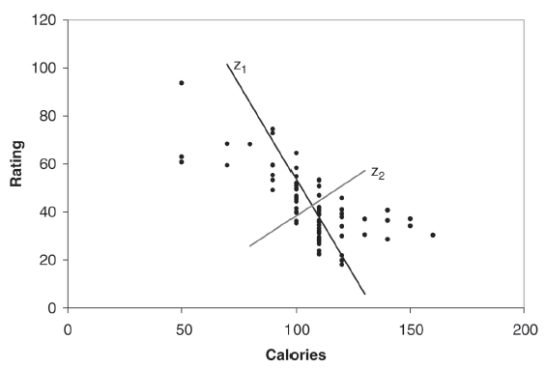
Principal Component Analysis
Z₁ and Z₂ are two linear combinations.
Z₁ has the highest variation (spread of values)
Z₂ has the lowest variation
PC1 PC2
[1,] 44.921528 2.1971833
[2,] -15.725265 -0.3824165
[3,] 40.149935 -5.4072123
[4,] 75.310772 12.9991256
[5,] -7.041508 -5.3576857

Slide 24
Python
Notes:
Guidelines
Use a title slide at the beginning of your presentation. There are 9 variations of title slides to choose from.
If you will have a series of slideshows, we recommend using the same style of title slide for each presentation.
Keep your title to no more than 2 lines.
Do not change the font style or font size of the title or subtitle.

Slide 25
Selecting the Number of PCs
You can predetermine the percent of variation to keep
Say you wish to keep the number of PCs that account for >90%
PC1 PC2 PC3 PC4 PC5 PC6
Standard deviation 83.7641 70.9143 22.6437 19.1815 8.4232 2.0917
Proportion of variance 0.5395 0.3867 0.0394 0.0283 0.0055 0.0003
Cumulative proportion 0.5395 0.9262 0.9656 0.9939 0.9993 0.9997
PC7 PC8 PC9 PC10 PC11 PC12 PC13
Standard deviation 1.6994 0.7796 0.6578 0.3704 0.1864 0.063 0.0
Proportion of variance 0.0002 0.0000 0.0000 0.0000 0.0000 0.000 0.0
Cumulative proportion 0.9999 1.0000 1.0000 1.0000 1.0000 1.000 1.0
The first two components account for 93% of the total variance, so using 2-3 components in further modeling would probably be sufficient

Slide 26
Python
Notes:
Guidelines
Use a title slide at the beginning of your presentation. There are 9 variations of title slides to choose from.
If you will have a series of slideshows, we recommend using the same style of title slide for each presentation.
Keep your title to no more than 2 lines.
Do not change the font style or font size of the title or subtitle.

Slide 27
Selecting the Number of PCs
We must normalize the data prior to PCA
Normalizing avoids high-variance variables to dominate
PC1 PC2 PC3 PC4 PC5 PC6
Standard deviation 1.9192 1.7864 1.3912 1.0166 1.0015 0.8555
Proportion of variance 0.2795 0.2422 0.1469 0.0784 0.0761 0.0555
Cumulative proportion 0.2795 0.5217 0.6685 0.7470 0.8231 0.8786
PC7 PC8 PC9 PC10 PC11 PC12 PC13
Standard deviation 0.8251 0.6496 0.5658 0.3051 0.2537 0.1399 0.0
Proportion of variance 0.0517 0.0320 0.0243 0.0071 0.0049 0.0015 0.0
Cumulative proportion 0.9303 0.9623 0.9866 0.9936 0.9985 1.0000 1.0

Slide 28
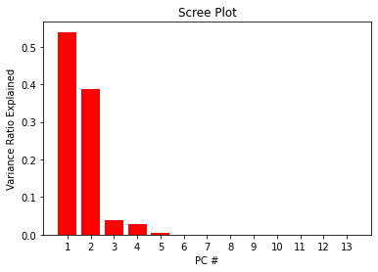
Selecting the Number of PCs
You can use a scree plot to determine the contribution of PCs

Slide 29
Python
Notes:
Guidelines
Use a title slide at the beginning of your presentation. There are 9 variations of title slides to choose from.
If you will have a series of slideshows, we recommend using the same style of title slide for each presentation.
Keep your title to no more than 2 lines.
Do not change the font style or font size of the title or subtitle.

